Slide 1




SOLID
Design Principles and Approaches
C# OOP
Advanced
SoftUni Team
Technical Trainers
Software University
http://softuni.bg

Slide 2

Table of Contents
Single Responsibility Principle
Open/Closed Principle
Liskov Substitution Principle
Interface Segregation Principle

Slide 3
Questions
sli.do #CSharp-OOP

Slide 4
Why Clean Code Matters?
How clean code (or its absence) affects our software?
“If you want to go fast you must go clean”
– Robert C. Martin

Slide 5
SOLID Principles
SRP
OCP
ISP
LSP
DIP
Notes:
Only when you apply the whole package you get a good design

Slide 6
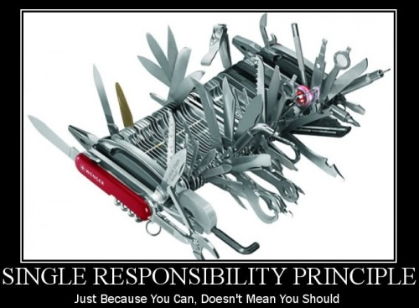
Single Responsibility

Slide 7

What is Single Responsibility?
Every object should have a single responsibility and that responsibility should be entirely encapsulated by the class.
“There should never be more than one reason for a class to change.”
- Robert C. “Uncle Bob” Martins

Slide 8
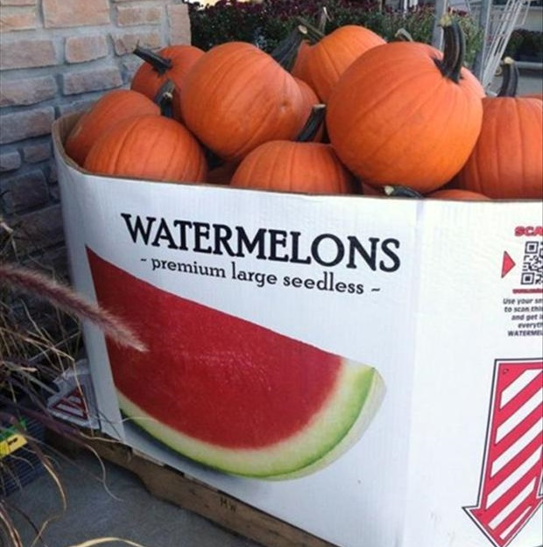
High Cohesion / Low Coupling
Cohesion – how closely all the routines in a class or all the code in a routine support a central purpose
Focused on one task
Maximum cohesion - each variable is used by each method
Notes:
Cohesion
Low: The convenience store. You go there for everything from gas to milk to ATM banking. Products and services have little in common, and the convenience of having them all in one place may not be enough to offset the resulting increase in cost and decrease in quality.
High: The cheese store. They sell cheese. Nothing else. Can't beat 'em when it comes to cheese though.
More inner instance variables – harder cohesion
Coupling
Loose: You and the guy at the convenience store. You communicate through a well-defined protocol to achieve your respective goals - you pay money, he lets you walk out with the bag of Cheetos. Either one of you can be replaced without disrupting the system.
Tight: You and your wife.

Slide 9
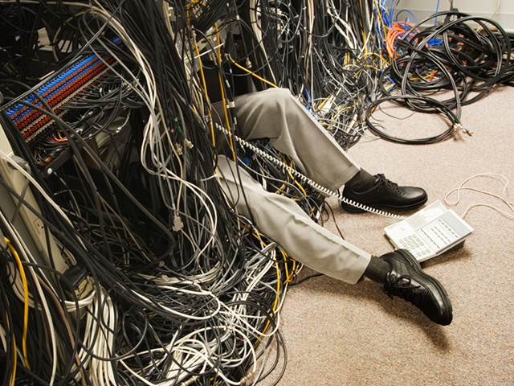
High Cohesion / Low Coupling (2)
Coupling – how much one component knows about the inner elements of another one
Dependency on other modules
Relationship between modules
Each system needs a correct level of coupling between pieces in order to do something
Notes:
Cohesion
Low: The convenience store. You go there for everything from gas to milk to ATM banking. Products and services have little in common, and the convenience of having them all in one place may not be enough to offset the resulting increase in cost and decrease in quality.
High: The cheese store. They sell cheese. Nothing else. Can't beat 'em when it comes to cheese though.
More inner instance variables – harder cohesion
Coupling
Loose: You and the guy at the convenience store. You communicate through a well-defined protocol to achieve your respective goals - you pay money, he lets you walk out with the bag of Cheetos. Either one of you can be replaced without disrupting the system.
Tight: You and your wife.

Slide 10
Responsibility Problem
More requirements –> more possible changes
More responsibilities –> more changes in code
Multiple responsibilities in one class –> coupling
More coupling –> more ERRORS upon change

Slide 11
Design Smell - Violations
Poorly
selected
boundaries
God Object
Coupling
Destructive
decoupling
IDEAL
Cohesion
Notes:
Ideal – highly cohesive domains minimally coupled
God Object – one object doing everything and coupled to many modules
Boundaries – the boundaries do not represent the actual semantics of the domain
Destructive decoupling – when you try to decouple that much that objects loose cohesion

Slide 12
Approaches
Small number of instance variables inside a class
Each method of a class should manipulate one or more of those variables.
Two modules should exchange as little information as possible
Is the subsystem easily reusable in another project?

Slide 13
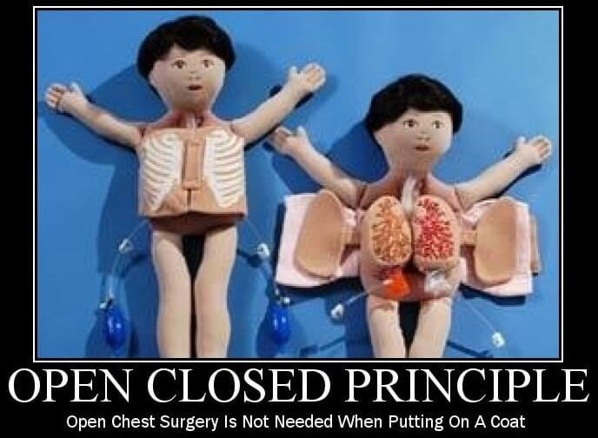
Open/Closed

Slide 14
What is Open/Closed?
Software entities like classes, modules and functions should be open for extension but closed for modifications
Extensibility – adding new behavior doesn’t require changes over the existing source code
Reusability – subsystems are suitable for reusing in other projects – modularity

Slide 15

Design Smell - Violations
Need to retest after changes
Old parts changed -> possible bugs
Cascading changes through modules
Logic depends on conditional statements (“is a” checking)

Slide 16
Approaches
Parameters - control behavior specifics via a parameter, delegate
Rely on abstraction, not implementation
Inheritance / Template Method Pattern
Composition / Strategy Pattern
Plug in model (insert new implementation of the interface)
Client code depends on abstraction – utilize Composition to set a inner field
Notes:
When we use abstraction there is no limit in implementation

Slide 17
When to apply
By experience – know the problem domain and if a change / modification is very likely to recur
New domain problem – implement the most simple way
Changes once – modify, second time – refactor
TANSTAAFL – There Ain’t Such Thing As A Free Lunch
OCP adds complexity to design
No design can be closed against all changes - know which ones to guard
Notes:
It's best not to try to predict the future, but once a change is needed, modify the design so future changes of that same kind can be accommodated.

Slide 18
Template Method Pattern
FrameWorkClass
+ templateMethod()
+ stepOne()
+ stepTwo()
+ stepTwo()
. . .
Application ClassOne
+ stepTwo()
Application ClassTwo
+ stepTwo()

Slide 19
Template Method Pattern (2)
public abstract class CrossCompiler
{
public void CrossCompile()
{
this.CollectSource();
this.CompileToTarget();
}
//Template methods
protected abstract void CollectSource();
protected abstract void CompileToTarget();
}

Slide 20
Template Method Pattern (3)
public class IPhoneCompiler : CrossCompiler
{
protected override void CollectSource() { //sth spec}
protected override void CompileToTarget()
{ //iphone specific compilation }
}
public class AndroidCompiler : CrossCompiler
{
protected override void CollectSource() {//sth spec}
protected override void CompileToTarget()
{ //android specific compilation }
}

Slide 21

SRP and OCP Exercise
Live Exercises in Class (Lab)

Slide 22
Problem: Stream Progress Info
Refactor skeleton given for this problem:
StreamProgressInfo class must work with Music class too
Be sure if you add new class which provide BytesSent and Length getters will work without touching StreamProgressInfo

Slide 23
Solution: Stream Progress Info
public class StreamProgressInfo
{
private IStreamable streamable;
public StreamProgressInfo(IStreamable streamResult)
{
this.streamable = streamResult;
}
public int CalculateStreamProgress()
{ return (this.streamable.BytesSent * 100) /
this.streamable.Length;
}
}
Notes:
There are two ways to achieve abstraction
- Using Abstract Classes
- Using Interfaces

Slide 24
Solution: Stream Progress Info (2)
public interface IStreamable
{
int Length { get; }
int BytesSent { get; }
}
public class File : IStreamable {
//TODO: Add business logic
}
public class Music : IStreamable {
//TODO: Add business logic
}
Notes:
There are two ways to achieve abstraction
- Using Abstract Classes
- Using Interfaces

Slide 25
Problem: Graphic Editor
Refactor skeleton given for this task so
GraphicEditor class draw all kind of shapes without asking what kind of shape we pass
Be sure if you add new type of shape system will work correctly without touching GraphicEditor

Slide 26
Solution: Graphic Editor
public class GraphicEditor
{
void DrawShape(Shape shape)
{ shape.Draw(); }
}
public interface IShape {
void Draw();
}
public class Rectangle : IShape
{
public void Draw()
{
Console.WriteLine("I'm Rectangle");
}
}
//TODO: Make the same for Circle
Notes:
There are two ways to achieve abstraction
- Using Abstract Classes
- Using Interfaces

Slide 27
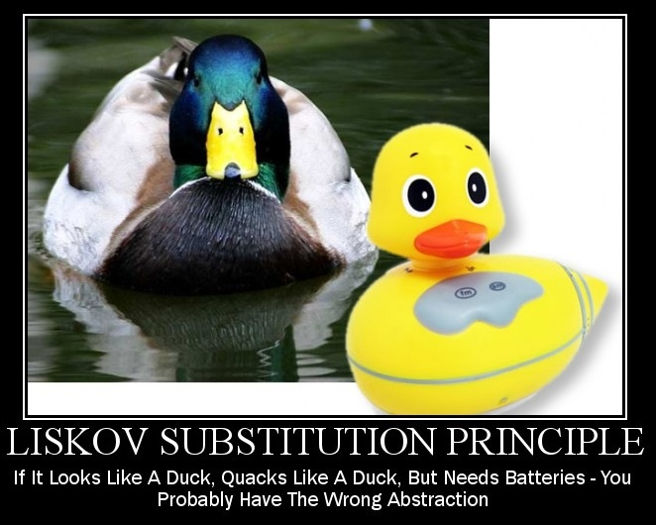
Liskov Substitution

Slide 28
What is Liskov Substitution?
“Derived types must be completely substitutable for their base types”
– Barbara Liskov, 1988

Slide 29
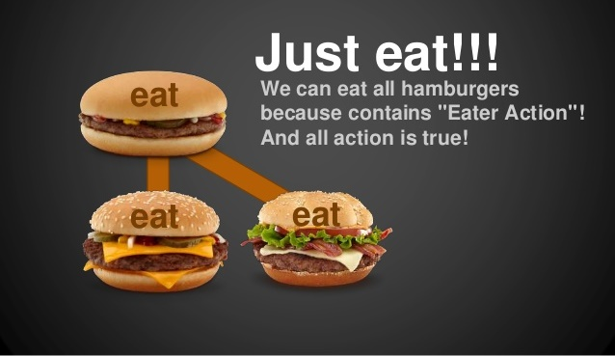
Substitutability
Reference to the base class can be replaced with a derived class without affecting the functionality of the program module
Derived class only extends functionalities of the base class
Derived class must not remove base class behavior

Slide 30
LSP Relationship
OOP Inheritance
Plus LSP
Student IS-A Person
Student IS-SUBSTITUTED-FOR Person
Notes:
E.g. Animal is substitutable for Dog

Slide 31
Design Smell - Violations
Type Checking
Overridden methods say "I am not implemented"
Base class depends on its subtypes

Slide 32
OCP – Approaches
Tell Don’t Ask – if you need to check what is the object - move the behavior inside the object
New Base Class - two classes share common behavior but are not substitutable, create third from which both derive
There shouldn’t be any virtual methods in constructors
Notes:
Usually from base ctor to child
Virtual methods from child to base
Base class – depends on the child

Slide 33

Interface Segregation

Slide 34
What is Interface Segregation?
"Clients should not be forced to depend on methods they do not use."
Agile Principles, Patterns, and Practices in C#
Segregate interfaces
Prefer small, cohesive (lean and focused) interfaces
Divide "fat" interfaces into "role" interfaces
Notes:
Получава се в два случая – малко от вас ще тръгнат да пишат огромни интерфейси, но дори и при два метода може да се получи грешка

Slide 35
Fat Interfaces
Classes whose interfaces are not cohesive have "fat" interfaces
public interface IWorker
{
void Work();
void Sleep();
}
Class Employee is OK
public class Robot : IWorker
{
void Work() {}
void Sleep()
{ throw new NotImplementedException() }
}

Slide 36
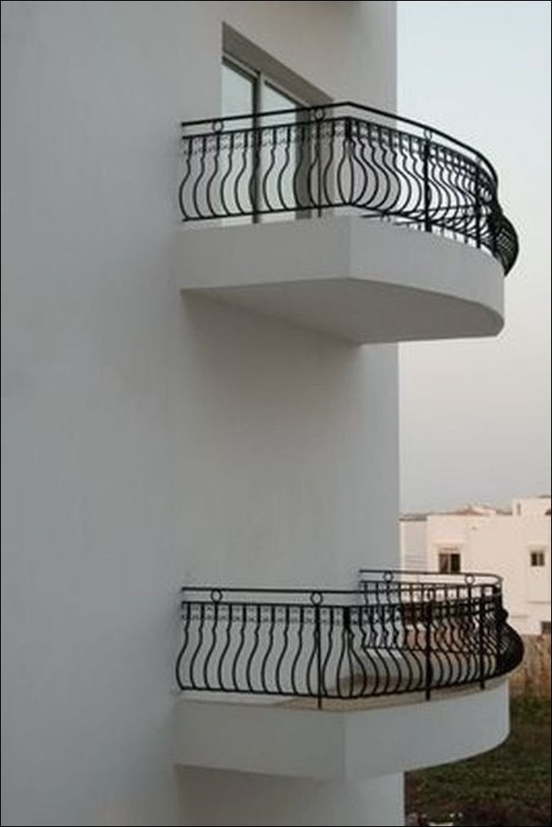
Design Smells - Violations
Not implemented methods
Client references a class but only use small portion of it
“Abstraction is elimination
of the irrelevant and
amplification of the essential.”
– Robert C. Martin

Slide 37
ISP - Approaches
What does the client see and use?
The “fat” interfaces implement a number of small interfaces with just what you need
All public members of a class divided in separate classes – again could be thought of as an interface
Let the client define interfaces – "role" interfaces

Slide 38
Cohesive Interfaces
Small and Cohesive "Role" Interfaces
public interface IWorker
{
void Work();
}
public interface ISleeper {
void Sleep();
}
public class Robot : IWorker
{
void Work() { // Do some work… }
}

Slide 39
Adapter Pattern
Convert the interface of a class into another interface clients expect.
Wrap an existing class with a new interface.

Slide 40
LSP and ISP Exercise
Live Exercises in Class (Lab)

Slide 41
Problem: Detail Printer
Refactor skeleton given for this task so that
DetailsPrinter class prints correctly any kind of employee, which is in the collection
Remove any “is “ from your code
Be sure if you add new type of employee system that it will work correctly without touching DetailsPrinter

Slide 42
Solution: Detail Printer
public class Employee
{
private string name;
public Employee(string name)
{
this.name = name;
}
public override string ToString()
{
return $"Name: {this.name}";
}
}
Notes:
There are two ways to achieve abstraction
- Using Abstract Classes
- Using Interfaces

Slide 43
Solution: Detail Printer (2)
public class Manager : Employee {
public Manager(string name,
ICollection<string> documents) : base(name)
{
this.Documents = new List<string>(documents);
}
public IReadOnlyCollection<string> Documents {get;set;}
public override string ToString()
{
return base.ToString() + $"Documents:
{string.Join(Environment.NewLine, this.Documents)}";
}
}
Notes:
There are two ways to achieve abstraction
- Using Abstract Classes
- Using Interfaces

Slide 44
Solution: Detail Printer (3)
public class DetailsPrinter {
private IList<Employee> employees;
public DetailsPrinter(IList<Employee> employees)
{
this.employees = employees;
}
public void PrintEmployees()
{
foreach(Employee employee in employees)
Console.WriteLine(employee);
}
}
Notes:
There are two ways to achieve abstraction
- Using Abstract Classes
- Using Interfaces

Slide 45
Problem: Recharge
You are given some classes
Refactor the code so that it conforms to ISP
* Consider the case that you don't own the library
New feature
Recharge Station
<IRechargeable>
(A) Worker
Current library
Employee
Robot

Slide 46
Solution: Rechargeable
Multiple Inheritance (If you own the library)
Recharge Station
<IRechargeable>
<ISleeper>
(A) Worker
Robot
Employee

Slide 47
Solution: Rechargeable (2)
Adapter Pattern (If you don't own the library)
Recharge Station
<IRechargeable>
(A) Worker
RobotAdapter
Robot
Employee

Slide 48
Problem: Security Door
You are given some classes
Refactor the code so that it conforms to ISP
(A) SecurityCheck
KeyCardCheck
PinCodeCheck
<ISecurityUI>
+RequestKeyCard():string
+RequestPinCode():int

Slide 49
Solution: Security Door
(A) SecurityCheck
KeyCardCheck
PinCodeCheck
<IKeyCardUI>
+RequestKeyCard():string
<IPinCodeUI>
++RequestPinCode():int
<ISecurityUI>

Slide 50
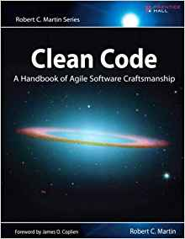


Useful Books
Clean code
Code Complete
Agile Principles, Patterns and Practices in C#

Slide 51
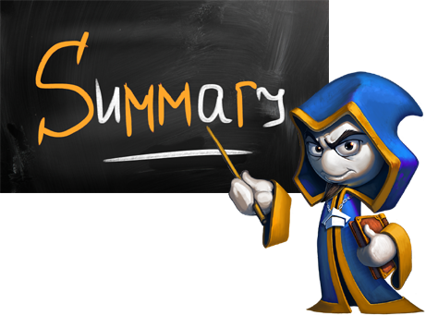

Summary
SRP - Violations
OCP - Violations
LSP - Violations
ISP - Violations

Slide 52







SOLID
https://softuni.bg/courses/

Slide 53
License
This course (slides, examples, demos, videos, homework, etc.) is licensed under the "Creative Commons Attribution-NonCommercial-ShareAlike 4.0 International" license

Slide 54




Trainings @ Software University (SoftUni)
Software University – High-Quality Education, Profession and Job for Software Developers
softuni.bg
Software University Foundation
softuni.org
Software University @ Facebook
facebook.com/SoftwareUniversity
Software University Forums
forum.softuni.bg

